Slide 1

TDD & Refactoring
Kevin Cunningham
TDD

Slide 2
Plan for Session
Refactoring
How to Identify Need for Refactoring
Keeping Code Clean
Bad Code Smells
Anti-Patterns

Slide 3
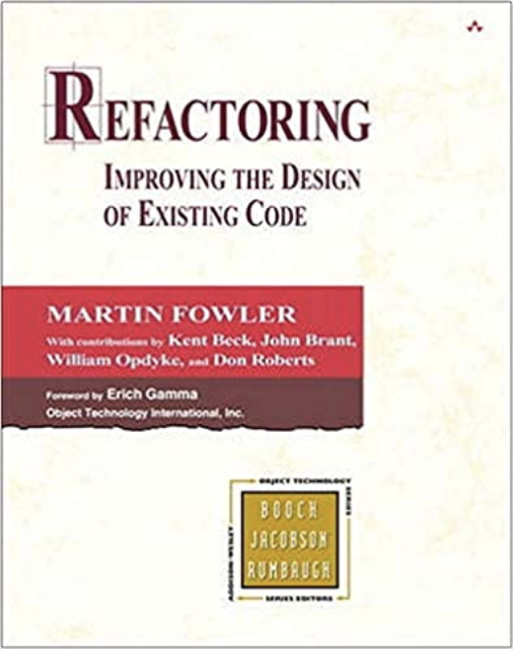
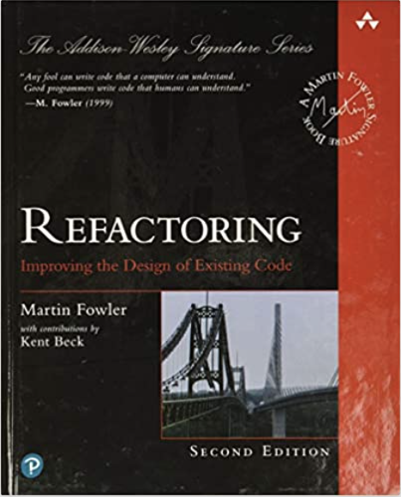
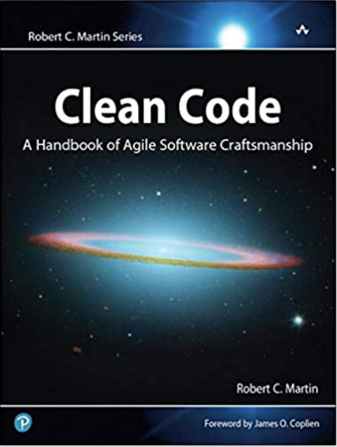
Refactoring
What is refactoring?
Refactoring is a ”interface-preserving transformation"
Martin Fowler defines it as
"a change made to the internal structure of software to make it easier to understand and cheaper to modify without changing its observable behavior"
Refactoring motivation
Make it easier to add new code
Improve the design of existing code
Gain a better understanding of code
Improve the clarity of the code
Refine the effectiveness of the code

Slide 4
Refactoring
Is a key aspect of TDD
Makes it more than just Testing or Test First Development
Places the focus on (re)design and incremental improvement
Tests provide for specification of what is needed as well as verification that existing behaviour is maintained
Without Refactoring TDD isn’t TDD!

Slide 5

How to Identify Need for Refactoring
Check for best practice adherence e.g. SOLID etc.
Look for unnecessary complexity
Keep it simple
Look for over simplicity
Look for Code Smells
Look for Code Anti-patterns
Look for language specific anti-patterns / code smells
Examine test code to ensure that is of the same quality, and subject to the same type of quality metrics as production code

Slide 6

Keeping Code Clean
Strive for simplicity
write the simplest test possible (given the behaviour)
Also applies to production code
only implement what is needed for the test
Refactor to improve quality of code
of both test and production code
Check execution paths
if there is no test, then either not required or tests missing
Follow best practice principles
naming principles / style guidelines
prefer immutability etc.
Notes:
S – Single Responsibility Principle
O – Open-Closed Principle
L – Liskov Substitution Principle
I – Interface Segregation Principle
D – Dependency Inversion Principle
Classes should be
open for extension; but closed for modification
Liskov Principle Objects in a program
should be replaceable with instances of their subtypes
Interface Segregation
Many client-specific interfaces
are better than one general-purpose interface

Slide 7
Bad Smells in Code
def add(x: Int): Int = {
A code smell is any symptom in the source code of a program, that possibly indicates a deeper problem
Code smells are heuristics indicating when to refactor, and what specific refactoring techniques to use
What is and is not a code smell is often a subjective judgment
Most Languages also possess language specific code smells

Slide 8
Generic Code Smells
def add(x: Int): Int = {
Range of Code Smells including
Shotgun Surgery
Duplicate Code
God Object / Lazy Class / Large Class
Feature Envy / Inappropriate Intimacy
Alternative classes with Different Interfaces but same behaviour
Refused Bequest
Long Method / Long Parameter list
Conditional Complexity
Speculative Generality (YAGNI)
Dead Code
Data Clumps / Primitive Data type Obsession
Notes:
Feature envy: a class that uses too mamny methods of another class excessively.
Inappropriate intimacy: a class that has dependencies on implementation details of another class.

Slide 9
Shotgun Surgery Code Smell
def add(x: Int): Int = {
Look to see how much code was affected by a change
Is this appropriate?
Does it seem to be too widely spread?
When a single change requires visiting many places in the code then some refactoring may be required!
May identify some Technical Debt

Slide 10
God / Monster Object Code Smell
def add(x: Int): Int = {
God object is an object that knows too much or does too much
Most of a program's overall functionality is coded into a single "all-knowing" object
Other objects within the program rely on the God object for most of their information and interaction
Refactor by
Breaking up into other objects
Single Responsibility Principle (SRP) etc.

Slide 11
Generic Code Smells Checklist
def add(x: Int): Int = {
Code smell is any symptom in source code that possibly indicates a deeper problem
Category | Smell
Bloaters | Long Method / Function Large Class Long Parameter List Primitive Data Type Obsession Data Clumps
Object-Oriented Abusers | God object Temporary Field Refused Bequest Alternate Class with Different Interface Parallel Inheritance Hierarchies Data class

Slide 12
Code Smells cont’d
def add(x: Int): Int = {
Category | Smell
Dispensable | Lazy Class Data Class Abuse Duplicate Code Speculative Generality
Encapsulators | Message Chain Middle Man
Couplers | Feature Envy Inappropriate Intimacy
Change Preventers | Divergent Changes Shotgun Surgery
Others | Incomplete Class Library Inconsistent Comments Conditional Complexity Tests not written to same standard as standard code

Slide 13
Language Specific Code Smells
def add(x: Int): Int = {
Each language has specific code smells
Become familiar with them, e.g.
Python, Kotlin, Go - using a method instead of a function
Go – don’t use panic unless absolutely necessary
In Python "pass" should not be used needlessly
Java avoid string concatenation use StringBuilder
Scala using an object as a mutable global variable
Javascript – var versus let
see https://www.geeksforgeeks.org/6-types-of-anti-patterns-to-avoid-in-software-development/
see https://docs.quantifiedcode.com/python-anti-patterns/
see https://dev.to/medhatdawoud/javascript-anti-patterns-2nia

Slide 14

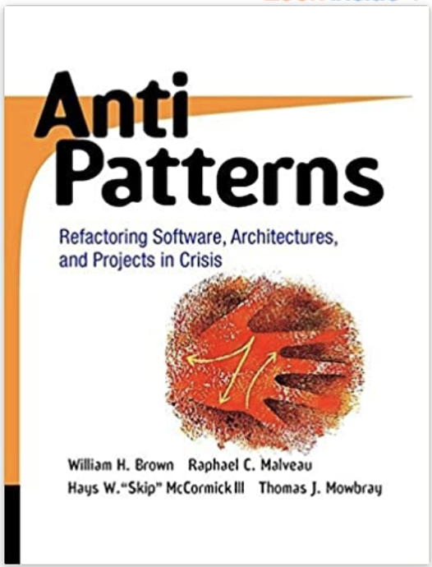
What are Anti-Patterns?
Commonly-reinvented bad solutions to problems
something that is commonly done and seems ok
but which has inherent issues associated with it
help to identify things to avoid in the future!
tend to be broader in scope than a code smell
Some examples
Object Cesspool, Yo-Yo
Textbook on anti-patterns
AntiPatterns: Refactoring Software, Architectures, and Projects in Crisis,
by Brown, Malveau, McCormick & Mowbray
Website on anti-patterns
http://en.wikipedia.org/wiki/Anti-patterns

Slide 15
Object Cesspool Anti-Pattern
Object Cesspool - a pool of dirty objects
use a pool to hold a cache of reusable objects
return objects to the pool when no longer required
But do not clean objects on return
Problems with Object Cesspool
recycled object might have state from previous incarnation
can cause confusion and inconsistency
Solution
clarify who is responsible for cleaning objects when returned
make sure objects are completely wiped of previous state

Slide 16
Poltergeist / Gypsy Anti-Pattern
Poltergeist classes constitute
often stateless classes / instances
temporary, short-duration objects and classes
single-operation classes that exist only to “seed” or “invoke” other classes through temporary associations
classes with “control-like” operation names such as start_process_alpha
Symptoms And Consequences
redundant navigation paths and Transient associations
polluted object space
can often use methods or functions instead

Slide 17
Resources: Refactoring
Martin Fowlers’ Refactoring site
https://refactoring.com/
Gilded Rose Refactoring Kata
https://github.com/emilybache/GildedRose-Refactoring-Kata
Refactoring Guru: Refactoring and Design Patterns
https://refactoring.guru/
6 Anti-patterns to avoid
https://www.freecodecamp.org/news/antipatterns-to-avoid-in-code/
Coding Horror: Code Smells
https://blog.codinghorror.com/code-smells/
Wikipedia
https://en.wikipedia.org/wiki/Code_refactoring

Slide 18
Questions?
?

